Slide 1



MIS779 Decision Analytics in Practice Assignment 2 – Part 1
Group 6
Shruthipriya Ghanathey -219557848

Slide 2

Advanced Data Analytics
Business Problem :
How do people view their weekly ‘choir’ experience?
Has this changed

Slide 3

Table of Contents:
Hypothesis
Data Preparation
Modelling
Hypothesis Test Outcome
Further Analysis and Literature.
Recommendations.

Slide 4
Hypothesis :
Choir members in the year 2021 are estimated to have a lower negative opinion and higher neutral opinion on the choir compared to the year 2019.
Test Method: Sentiment Analysis
Tools: Python

Slide 5
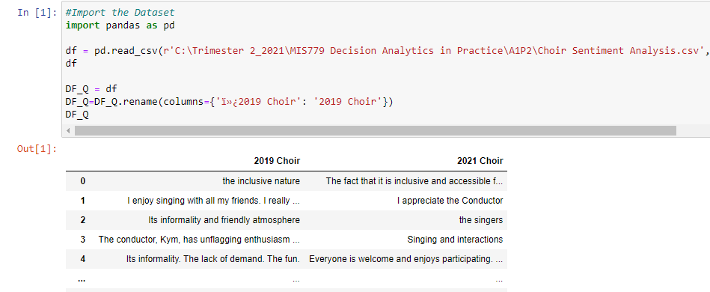
Data Preparation:
Data Used from the Years 2019 and 2021.
Questions Considered were:
2019:
Is there anything that you particularly like about the choir?
Is there anything that you particularly dislike about the choir?
2021:
What is the best thing about the choir?
Is there anything your particularly dislike about the choir?
Data cleaning:
Remove Missing Values
Tokenisation
Removing special characters, stop words.
Eliminating the Words < 3 characters

Slide 6
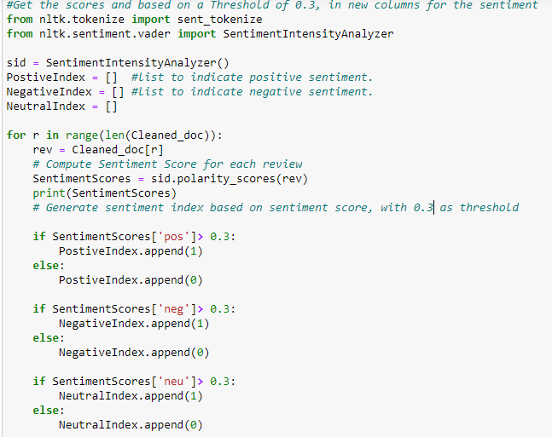
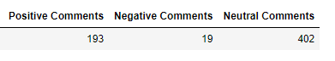
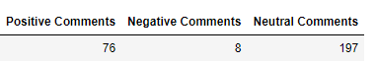
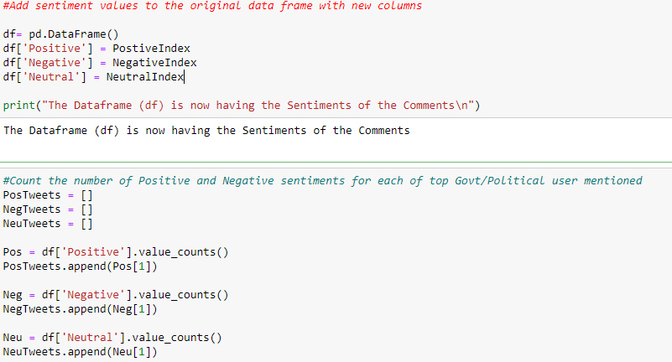
Modelling:
Using Sentiment Intensity Analyzer, with a threshold of 0.3.
2019
2021
Sentiment Score
Storing the scores in a Data frame

Slide 7
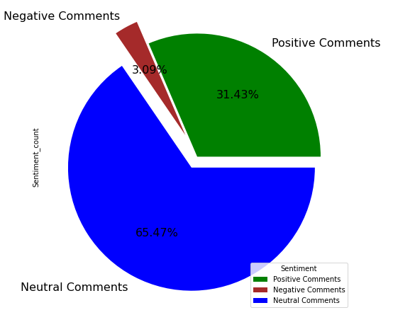
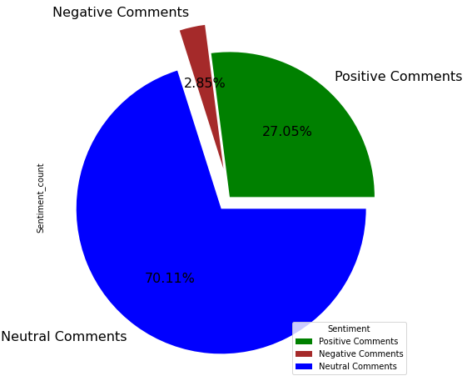
Hypothesis : Choir members in the year 2021 are estimated to have a lower negative opinion and higher neutral opinion on the choir compared to the year 2019. Claim Made is True.
Year 2019 Year 2021

Slide 8
Further Analysis and Literature:
Based on an article from the Forbes, a leader should always be focussed on their strengths as they are great resources for increasing the positive experience, compared to the working on weakness. (Suner, 2021)
Moreover, as majority of the choir members are neutral, they are not having any negative experience of the choir and not positive either.
Thus, we can focus on utilising the strengths of the choir to convert their neutral experience to positive.
Reference: Suner, E., 2021. Council Post: Why Leaders Should Focus On Strengths, Not Weaknesses. [online] Forbes. Available at: <https://www.forbes.com/sites/forbescoachescouncil/2020/02/06/why-leaders-should-focus-on-strengths-not-weaknesses/?sh=5fb7e7ec3d1a> [Accessed 22 September 2021].

Slide 9

Advanced Analysis:
What do People like about the choir.
Method: Using LDA Topic Modelling
Tools: Python.

Slide 10
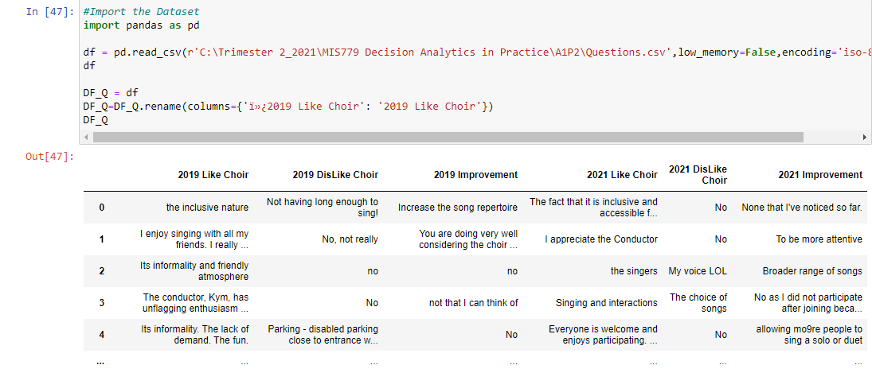
Data Preparation:
Year 2019 and
Question Used:
Is there anything that you particularly like about the choir?
Year 2021
Question Used:
Is there anything that you particularly like about the choir?

Slide 11
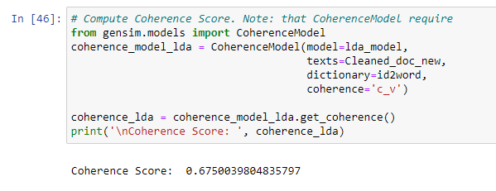
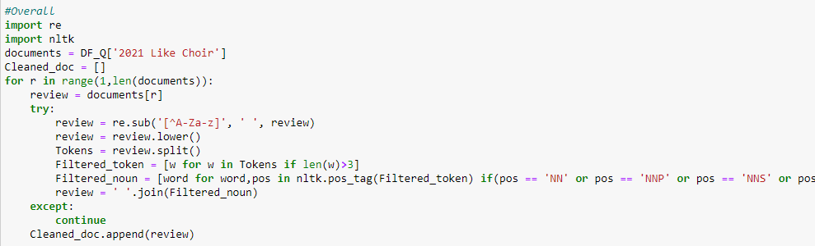
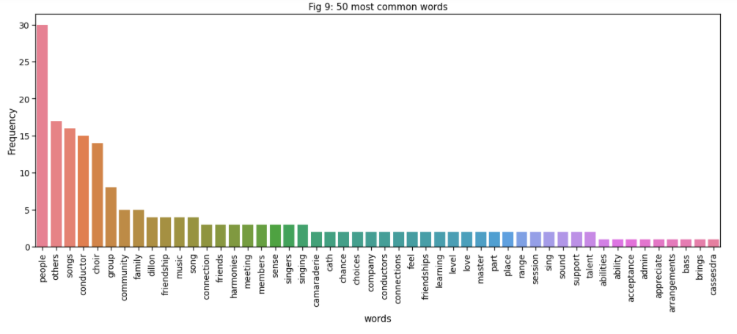
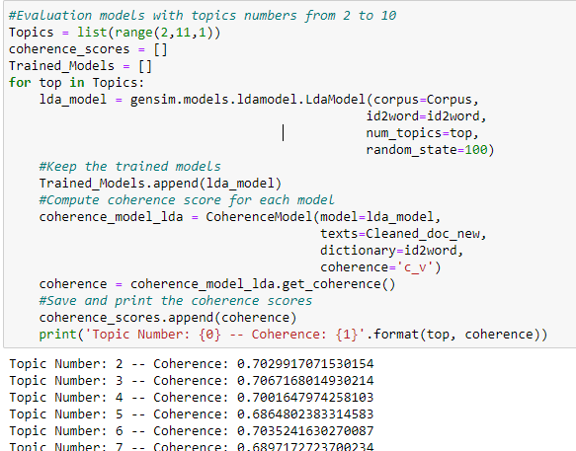
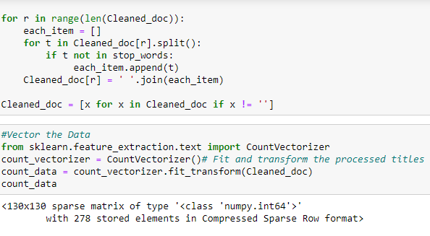
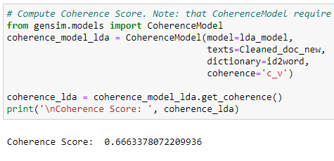
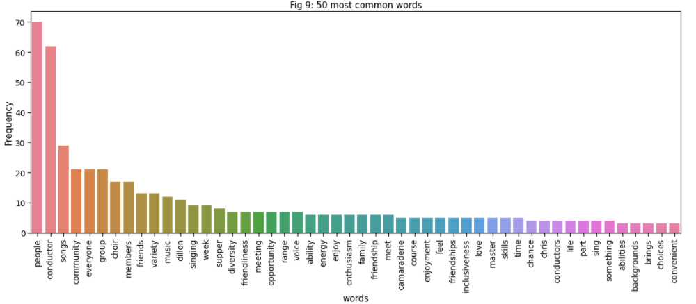
Topic Modelling:
Data Cleaning and selecting Nouns
2021 Frequent Words
LDA Genism Model
Removing Stop words
2019 Frequent Words

Slide 12
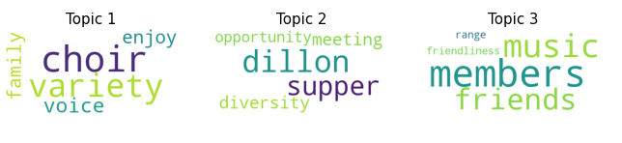
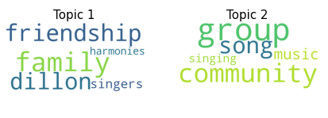
Analysis on Like about choir:
2019 2021
Insights:
People enjoy the choir with family with having a variety of voices singing.
People like the choir Music, members and their friendships.
People like the supper of choir ,its diversity and opportunity of meeting conductor Dillon
Insights:
People enjoy singing songs with the community and groups.
People like singing the harmonies with the family and friends held by conductor Dillon

Slide 13
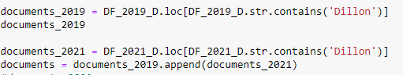
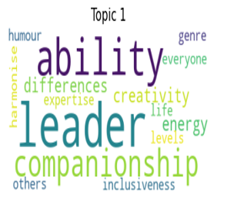
Further Analysis:
Since, from both the years, it can be seen that people have mentioned about Dillon, further analysis is performed on what people think about Dillon.
Based on the Modelling, we get the abilities of Dillon are:
Showing leadership qualities and making the choir inclusive for everyone with no differences.
Having high energy levels and good sense of humour and creativity than other conductors.
Providing companionship to everyone in genre of harmonies with expertise.

Slide 14

Recommendation :
Increase the frequency of the choirs conducted by the Dillon across all the choir locations. Since people have expressed to like Dillon’s performance. It would help to create positive experience for people towards the choir.
Moreover, Dillon can provide training to the conductors to maintain the similar positive experience across all the choirs.

Slide 15

Thank You

